Slide 1



2027 Retiree Program Overview
Listen, Read and Learn

Slide 2
About this presentation format
This is a voice-over, slide presentation that allows you to learn about the Valero Retiree Health Care Program at your own pace.
You can drag the slider below to quickly move ahead to other slides or replay slides again. You may return to this presentation at anytime.
The information in this presentation is designed for educational purposes only. The official plan documents govern this program.
Notes:
About this presentation format… This is a voice over “slide” presentation, which enables you to take your time to Listen, Read and Learn about the Valero Retiree heath care program.
You can click ahead to other slides, replay slides again and return to this presentation at any time, day or night.
This presentation is non-binding and is designed as an overview of the program. Only the official plan documents govern this program.

Slide 3

Content Overview
  Plan announcements and updates for 2027
  General administration of the Retiree Benefits Plan
  Overview of retiree medical benefit options:
    Non-Medicare medical benefit options (titles shown in BLUE)
    Medicare medical benefit options (titles shown in RED)
  Benefit provider contact information
  Helpful resources
Eligibility and benefits are governed by the terms of the Valero Energy Corporation Retiree Benefits Plan and/or the applicable insurance contracts/policies as the case may be. Valero reserves the right to amend or modify the retiree benefits plan, in whole or in part, from time to time.

Slide 4
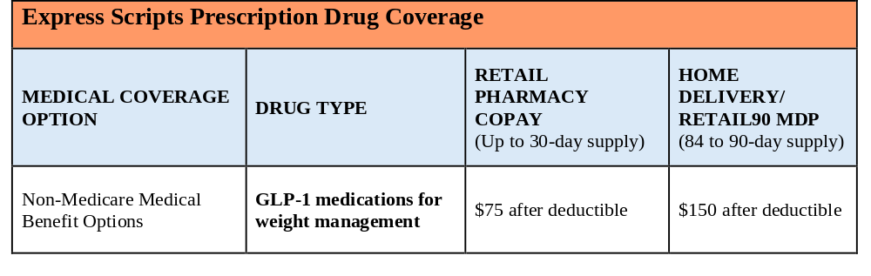
Non-Medicare Plan Updates for 2027
Copayments for GLP-1 medications prescribed for weight management, excluding diabetes treatment, for the 2027 plan year are as follows:
Kaia Health – Digital Health, Pain Management Solution will be transitioning to Sword Health effective January 1, 2027

Slide 5
GLP-1 Medications for Weight Management
Non-Medicare medical plan participants who are prescribed GLP-1 weight management medications must actively participate in the Omada Health program
  Omada Health is an online lifestyle modification program providing access to experts in weight loss and obesity management at no cost to participants
  To maintain coverage for the prescribed GLP-1 weight loss medication, participants must enroll in and actively participate in the program
  Active participation is defined as four weigh-ins using the smart scale provided by Omada Health and four app engagements per month
  These requirements are in addition to the standard prescription prior authorization requirement

Slide 6
Medicare Plan Updates for 2027
Your medical coverage will be updated to include any plan changes mandated by Medicare.
  This includes an increase of the out-of-pocket maximum for your Prescription Drug Coverage from $2,100 in 2026 to $2,400 in 2027

Slide 7
Retiree Health Care Administration
Valero partners with Amwins Group Benefits (Amwins) to administer the Valero Retiree Benefits Plan.
Amwins provides day-to-day program support as follows:
  Retiree health care enrollment, with representatives available to help retirees:
    Compare available plans
    Evaluate coverage options
    Make informed enrollment decisions
  Monthly retiree billing administration (typically through Automated Clearing House (ACH))
  Retiree health care related communications and annual notices
Notes:
Over the next couple of slides, we’ll discuss the administration of the Valero Retiree heath care program. First you should be aware that Valero has partnered with Amwins Group Benefits to provide the day to day administration. Amwins is responsible to provide
Retiree health care enrollment services and support – with this, Amwins will help you compare plans and make an educated decision on what to select.
Monthly retiree billing administration – Amwins will arrange your monthly payment for your heath care coverage, typically through an automatic bank deduction.
Amwins will provide Retiree health care related communications and notices
And finally, Amwins will provides day to day retiree support to all retirees and their eligible dependents that need help of any kind.

Slide 8
Retiree Health Care Administration
Amwins will provide enrollment kits and communications for the following reasons:
  Initial retirement enrollment
  Medicare eligibility due to age or disability
  Qualified Change Events (QCEs), including marriage, divorce, death, etc.
  Annual Open Enrollment
The 2027 Open Enrollment Period: October 15, 2026 – November 5, 2026
  Annual Open Enrollment is passive. If you do not wish to make changes, your benefits will automatically roll over
  Be sure to review your renewal letter for any premium rate changes for the 2027 plan year
Notes:
Continuing with the Amwins Retiree administration… Amwins will provide enrollment kits and communications for the following reasons:
They include Enrollment kits to Newly retired employees enrolling for the first time.
Enrollment Kits anytime a retiree or eligible dependent becomes Medicare eligible due to age or disability.
Amwins also provides enrollment kits for Qualified Change Event (QCE), such as marriage, divorce, death, etc. where coverage needs to be selected or cancelled.
An Annual Open Enrollment Kit is also provided for currently enrolled retirees considering changes for the next calendar year.
And finally, you should be aware that this year’s Annual Open Enrollment is – October 15 – November 5.
Annual Open Enrollment is passive, meaning if you don’t wish to make changes, your benefits will rollover automatically. Be sure to review your renewal letter for any premium rate changes for the 2027 plan year.

Slide 9
Retiree Health Care Administration
Retirees with both non-Medicare eligible and Medicare-eligible participants are considered to be a “Split Household”. When those participants in a split household become eligible for the same benefit options, they must enroll in the same non-Medicare or Medicare-eligible plan.
If you elect to waive any health care benefit option(s) under the Retiree Benefits Plan, your decision is irrevocable and no further opportunity to enroll in applicable medical, dental, or vision coverage will be permitted
The preferred method of payment for monthly retiree benefit premiums is through ACH
Confirmation of coverage and premium invoices are provided when enrollment is processed
Benefit vendors will send ID cards and applicable plan information directly to you via mail
Notes:
This slide covers some of the finer administrative rules surrounding the retiree benefits.

Slide 10
Retiree Health Care Administration
Qualified Change Event (QCE):
  A QCE is a change in a retiree’s circumstances that permits a mid-year change to retiree benefit elections outside of the Annual Open Enrollment period, such as:
    Marriage, divorce, death, loss of dependent status
  If you experience a QCE, you must submit written notification and supporting documentation for the QCE to Amwins within 30 days of the QCE
    This includes notifying Amwins of the ineligibility of a dependent
  Newly added dependents during Open Enrollment are required to provide documentation to support eligibility
Address/Personal Information Updates:
  Updates to address and personal data should be provided to Amwins
Notes:
This is the last slide on Administration before moving on to the Health Care benefit Options. The first item relates to a Qualified Change Event or QCE. A QCE is a change in an retiree’s situation that allows the retiree to change an election under the Valero retiree benefit plan outside of the annual open enrollment period. Qualifying change events include events such as marriage, death of a participant, the termination of a dependent, etc. Finally Address and Personal Information Updates should be provided to Amwins so they can update their systems.

Slide 11
Retiree Medical Benefit Options
Non-Medicare Medical Benefit Options
Administered through UnitedHealthcare (UHC)
$1,000 Deductible Retiree Choice Plus
Copay/$500 Deductible Retiree Choice Plus*
*An Out-of-Area $500 Deductible option is offered to participants residing outside of the UHC network.
Medicare Medical Benefit Options
Medicare Supplements administered through United American Insurance Company with Prescription Drug Coverage through Express Scripts Medicare | Basic Supplement
 | Enhanced Supplement
 | Premium Supplement
Medicare Advantage Plan administered through UnitedHealthcare with Prescription Drug Coverage through Express Scripts Medicare
Notes:
Non-Medicare eligible participants are offered two UnitedHealthcare (UHC) medical options:
$1,000 Deductible Retiree Choice Plus
Copay/$500 Deductible Retiree Choice Plus
There is also an Out-of-Area $500 Deductible Option is offered to those residing outside of the UHC network.
Medicare eligible participants are offered three Medicare Supplement w/Prescription Drug options and one Medicare Advantage w/Prescription Drug option:
The Medicare Supplement are through United American Insurance and Express Scripts Medicare Rx (combined). They are known as the Basic, Enhanced and Premium options –
Medicare Advantage with Prescription Drug coverage through UHC and Express Scripts Medicare Rx.

Slide 12
Retiree Health Care Benefit Options
Other benefits available regardless of Medicare:
Summaries of health care and legal insurance benefits are available on the website under the applicable links in the top navigation menu.
Dental, Vision and Legal Insurance
Benefit | Insurance Carrier
$50 Deductible Dental | UnitedHealthcare (UHC)
Vision Benefit | VSP
Legal Insurance | ARAG Insurance Co.

Slide 13
Non-Medicare Medical Coverage
Non-Medicare Medical Benefit Options
Administered through UnitedHealthcare (UHC)
$1,000 Deductible Retiree Choice Plus
Copay/$500 Deductible Retiree Choice Plus*
*An Out-of-Area $500 Deductible option is offered to participants residing outside of the UHC network.
  Deductibles, coinsurance, copayments and out-of-pocket maximums vary by benefit option
  Non-Medicare medical summaries, highlights and Summaries of Benefits and Coverage (SBCs) are available on the website under the applicable links in the top navigation menu

Slide 14

Non-Medicare Medical Coverage
Online resources are available from UHC
Manage your benefits and health care costs through www.myuhc.com or the UHC mobile app:
  View or print your ID cards
  Estimate health care costs
  Search for network providers
  Access Virtual Visits

Slide 15
Non-Medicare Benefit Highlights
Coverage is provided by UnitedHealthcare (UHC) and Express Scripts Rx
Preventive Care covered at 100% when receiving care from an in-network provider, including:
  Annual physicals and screenings
  Covered vaccinations
  Covered laboratory and imaging services (lab, x-rays, etc.)
Access care anytime through Virtual Visits
  See a doctor 24/7 from your smartphone, tablet or computer
  $15 copayment
  Most visits take approximately 10 to 15 minutes
  View the next slide to see all that is available through the virtual visits program

Slide 16
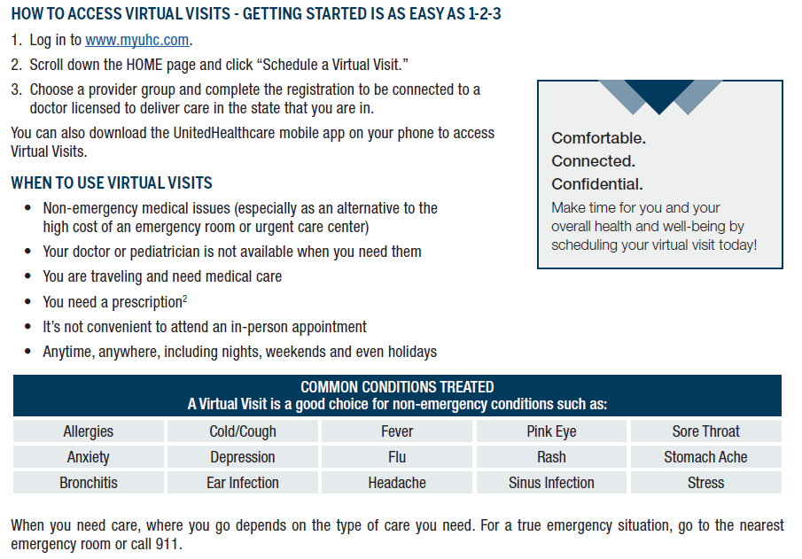
Non-Medicare Benefit Highlights

Slide 17
Non-Medicare Benefit Highlights
Personalized Musculoskeletal and Pelvic Health Support
Non-Medicare medical plan participants will have access to personalized musculoskeletal and pelvic health support with Sword effective January 1, 2027.
  Sword Health provides three virtual programs designed to help you feel your best: Thrive, Move and Bloom
  Thrive – Virtual physical therapy for back, joint and muscle pain is available through the Sword app – you can complete guided therapy sessions anytime, anywhere, helping reduce pain and improve mobility without leaving home
  Move – Personalized movement and wellness coaching is available through the Sword app and includes customized exercise plans supported by a Doctor of Physical Therapy
  Bloom – Virtual pelvic health support designed specifically for women. This program is designed to help women address pelvic health concerns, including bladder leakage, bowel disorders, pelvic pain and other related conditions
Notes:
Non-Medicare plan participants will have access to personalized musculoskeletal and pelvic health support through Sword Health effective January 1, 2027.
Whether you’re managing chronic pain, recovering from an injury, or looking to improve your overall movement and mobility, Sword Health offers convenient, personalized support from the comfort of home.
By combining advanced AI technology with expert clinical care, Sword Health provides three virtual programs designed to help you feel your best: Thrive, Move and Bloom.
Thrive connects you with a dedicated Doctor of Physical Therapy who creates a personalized treatment plan designed around your needs and goals.
Move helps you build healthy movement habits through customized exercise plans support by a Doctor of Physical Therapy.
Bloom is designed to help women address pelvic health concerns through personalized guidance and expert clinical support.

Slide 18

Non-Medicare Benefit Highlights
  In-Clinic and Remote Recovery
If you experience muscle or joint pain or want to improve mobility, Airrosti can help. Whether in person or virtually, Airrosti providers deliver conservative, effective care for muscle and joint conditions.
Treatment through Airrosti is a network benefit for retirees and their eligible dependents enrolled in Valero-sponsored, non-Medicare medical coverage
For all medical coverage options, once the annual out-of-pocket maximum is met, claims will be covered at 100%. Cost share for Remote Recovery is consistent with the Airrosti in-clinic benefit.
For more information, or to get started with treatment, contact Airrosti at (800) 404-6050 or visit www.airrosti.com.
Refer to the following table for the cost of Airrosti treatment based on the medical coverage option in which you are enrolled.
$1,000 Deductible Retiree Choice Plus | 20% Coinsurance (Deductible waived)
Copay/$500 Deductible Retiree Choice Plus | $35 Copay (Deductible waived)

Slide 19
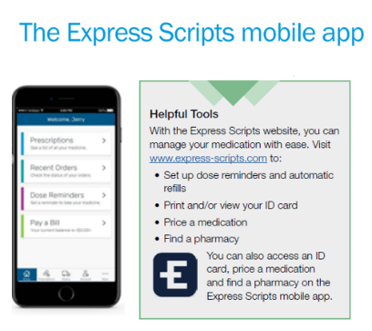
Non-Medicare Benefit Highlights
Express Scripts Prescription Drug Coverage
Retail 90 Maintenance Drug Program (MDP) or Home Delivery Program
  Cost-saving program that allows maintenance medications to be filled at a lower cost
  Maintenance drugs are prescriptions commonly used to treat chronic or long-term conditions
Accredo Specialty Drug Program
  Covered specialty medications must be filled through Accredo
  Certain specialty drugs may be eligible for SaveOnSP, a manufacturer copay assistance program that helps participants save money on specialty medications

Slide 20
Medicare Medical Coverage
Medicare Coverage includes both Medicare Supplement and Medicare Advantage Plan options to select from.
Deductibles, copayments and out-of-pocket maximums vary by benefit option.
Medicare Medical Benefit Options
Medicare Supplements administered through United American Insurance Company with Prescription Drug Coverage through Express Scripts Medicare | Basic Supplement
 | Enhanced Supplement
 | Premium Supplement
Medicare Advantage Plan administered through UnitedHealthcare with Prescription Drug Coverage through Express Scripts Medicare

Slide 21
Medicare Medical Coverage
Enrollment in Medicare Parts A and B are required to participate in a Valero- sponsored Medicare medical benefit option.
  Supplement (UA Basic, Enhanced, and Premium) plans pay secondary to Medicare (plans fill gaps in traditional Medicare)
  No provider referrals are needed when using care
  No networks to coordinate with, you can visit any Medicare provider
  The Medicare Supplement options, and the Medicare Advantage Plan option includes Medicare Prescription Drug (Part D) coverage through Express Scripts Medicare
  The Express Scripts Medicare Part D plan is different than the non-Medicare Express Scripts prescription drug coverage
  Enrollment in a separate Medicare plan or Part D Prescription Drug plan will impact your enrollment in a Valero-sponsored Medicare benefit option

Slide 22

Medicare Benefit Highlights
Medicare Supplement Coverage is provided by United American Ins. Co.
  Three supplement options available: Basic, Enhanced and Premium
  All options provide:
    100% Part A hospital coverage (up to 515 days)
    100% Part A skilled nursing facility coverage (up to 100 days)
    100% Medicare-covered preventive services
    Part B coverage that varies by plan option
    Foreign travel emergency coverage
    Express Scripts Medicare Part D prescription drug coverage
  Additional plan information is available on the website under the Medicare link

Slide 23

Medicare Benefit Highlights
Medicare Advantage Plan
  100% coverage for approved inpatient hospital services, you pay $0
  100% coverage for approved outpatient medical services, you pay $0
  Prescription Drug benefits are included and provided by Express Scripts Medicare
  Additional benefits available through the UHC Medicare Advantage Plan include:
    Annual Physical and Wellness Visit
    RenewActive® Gym and Fitness program
    HouseCalls® In-home Preventive Care Visit
    24/7 Nurse Support – speak to a registered nurse over the phone 24/7
    Chronic Conditions Programs – helps members with chronic diseases
    Virtual Visits – see your doctor online
    Online resources customized for you with your login:
      Claims information, ID cards, Physician lookup tools

Slide 24

Medicare Benefit Highlights
Medicare Advantage Plan
  The Medicare Advantage plan replaces traditional Medicare and pays all coverage
  In and Out of Network benefits are the same for the participant – as long as the provider accepts Medicare
  In-network providers are already established with UnitedHealthcare for billing purposes
  Out-of-network providers must accept the plan’s payment or additional paperwork may be required of the participant
  Hospital and medical benefits are covered at 100%, based on the plan’s terms and conditions
  Additional plan information can be found on the website under the Medicare link

Slide 25

Medicare Benefit Highlights
Medicare Prescription Drug Coverage is provided by Express Scripts Medicare
  All Medicare benefit options include the same Express Scripts Medicare (Part D) prescription drug coverage
  More than 66,000 participating pharmacies in the network
  There is a formulary list (covered drug list) to check your prescriptions against
  Online access is available to:
    View your pharmacy claims and spending
    Look-up and price your covered drugs and alternative drugs
    Find a pharmacy by zip code
    Order your refills, etc.
  Amwins can also assist with researching your covered drugs for you

Slide 26
Benefit Providers – Contact Info
Non-Medicare - Medical and Prescription Drug
Provider | Toll-Free Number | Website
UnitedHealthcare | (844) 634-1235 | www.myuhc.com
Express Scripts | (800) 294-5060 | www.express-scripts.com
Medicare Eligible - Medical and Prescription Drug
United American Ins. Co. | (800) 730-4648 | www.unitedamerican.com
UnitedHealthcare Medicare Advantage Plan (MA) | (844) 481-8836 | www.uhcretiree.com/valero
Express Scripts Medicare Prescription Drug Plan | (855) 778-1503 | www.express-scripts.com
Dental, Vision and Legal Insurance Benefits
UnitedHealthcare | (844) 634-1235 | www.myuhc.com
VSP Vision | (800) 877-7195 | www.vsp.com
ARAG Legal Insurance | (800) 247-4184 | www.araglegal.com/myinfo

Slide 27

Helpful Resources
Amwins Group Benefits (Amwins)
Customer Service Representatives available Monday – Friday, 7:00 a.m. – 7 p.m. CST.
: (877) 422-4170
Retiree Health Care Benefits Website: http://valero.amwins.com
Valero Health and Welfare Benefits Department
: (800) 333-3377 ext. 4000  (Email): welfarebenefits@valero.com
Notes:
Your primary contact for all Valero retiree program information is Amwins Group Benefits, Inc. Their phone number is listed here and on all the Valero retiree communication materials and website. If you have a Valero direct question, which you believe Amwins will be unable to assist you with, then please call the Valero Health and Welfare Benefits Department at the number displayed. Also, all program information including annual announcements, plans summaries and other pertinent data is available at Valero.amwins.com

